Slide 1
Name - Tarachand sahu
Class - Bsc 1st year (maths)
Topic - kepler's law
Date – 29.05.2021
Government College Gurur

Slide 2


Slide 3
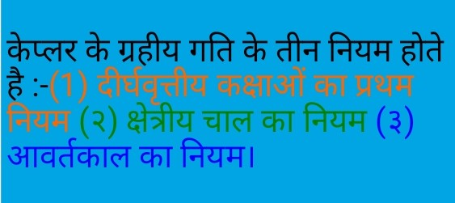

Slide 4
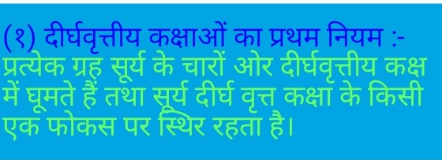

Slide 5
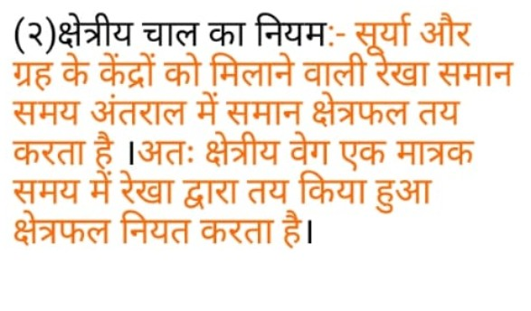

Slide 6
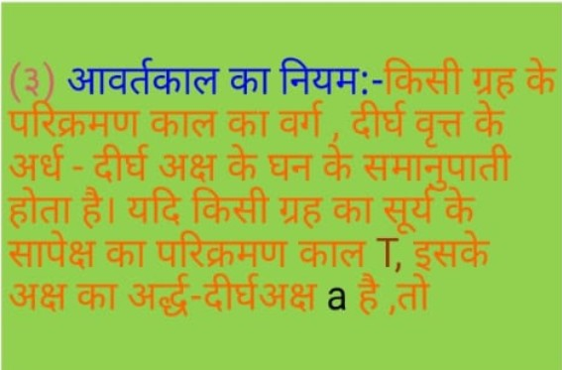

Slide 7
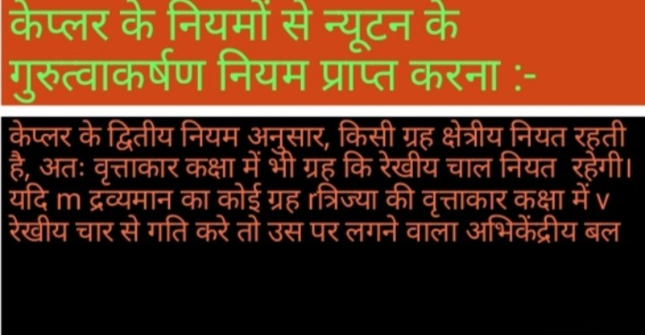

Slide 8
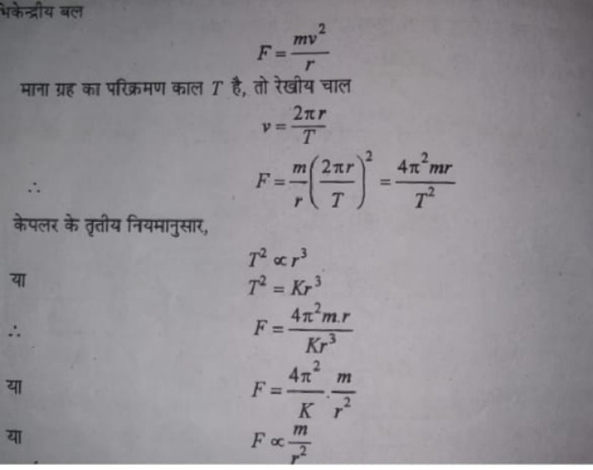

Slide 9
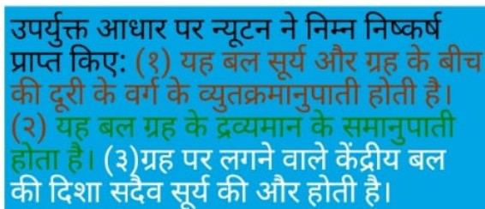

Slide 10


